Slide 1
Introduction to Computing for Data Analysis
Does my (numerical) program compute the right answer?
Richard Vuduc, Ph.D.
Associate Professor
School of Computational Science and Engineering
A small surprise?
Notes:
At this point, you’ve seen a few examples of how finite representations of numbers can affect numerical computation.
But you might be wondering, okay, so how does this affect me?
To answer that, I’d like you to think about the following example, which you might find surprising.

Slide 2

Notes:
Consider the following program fragment.

Slide 3
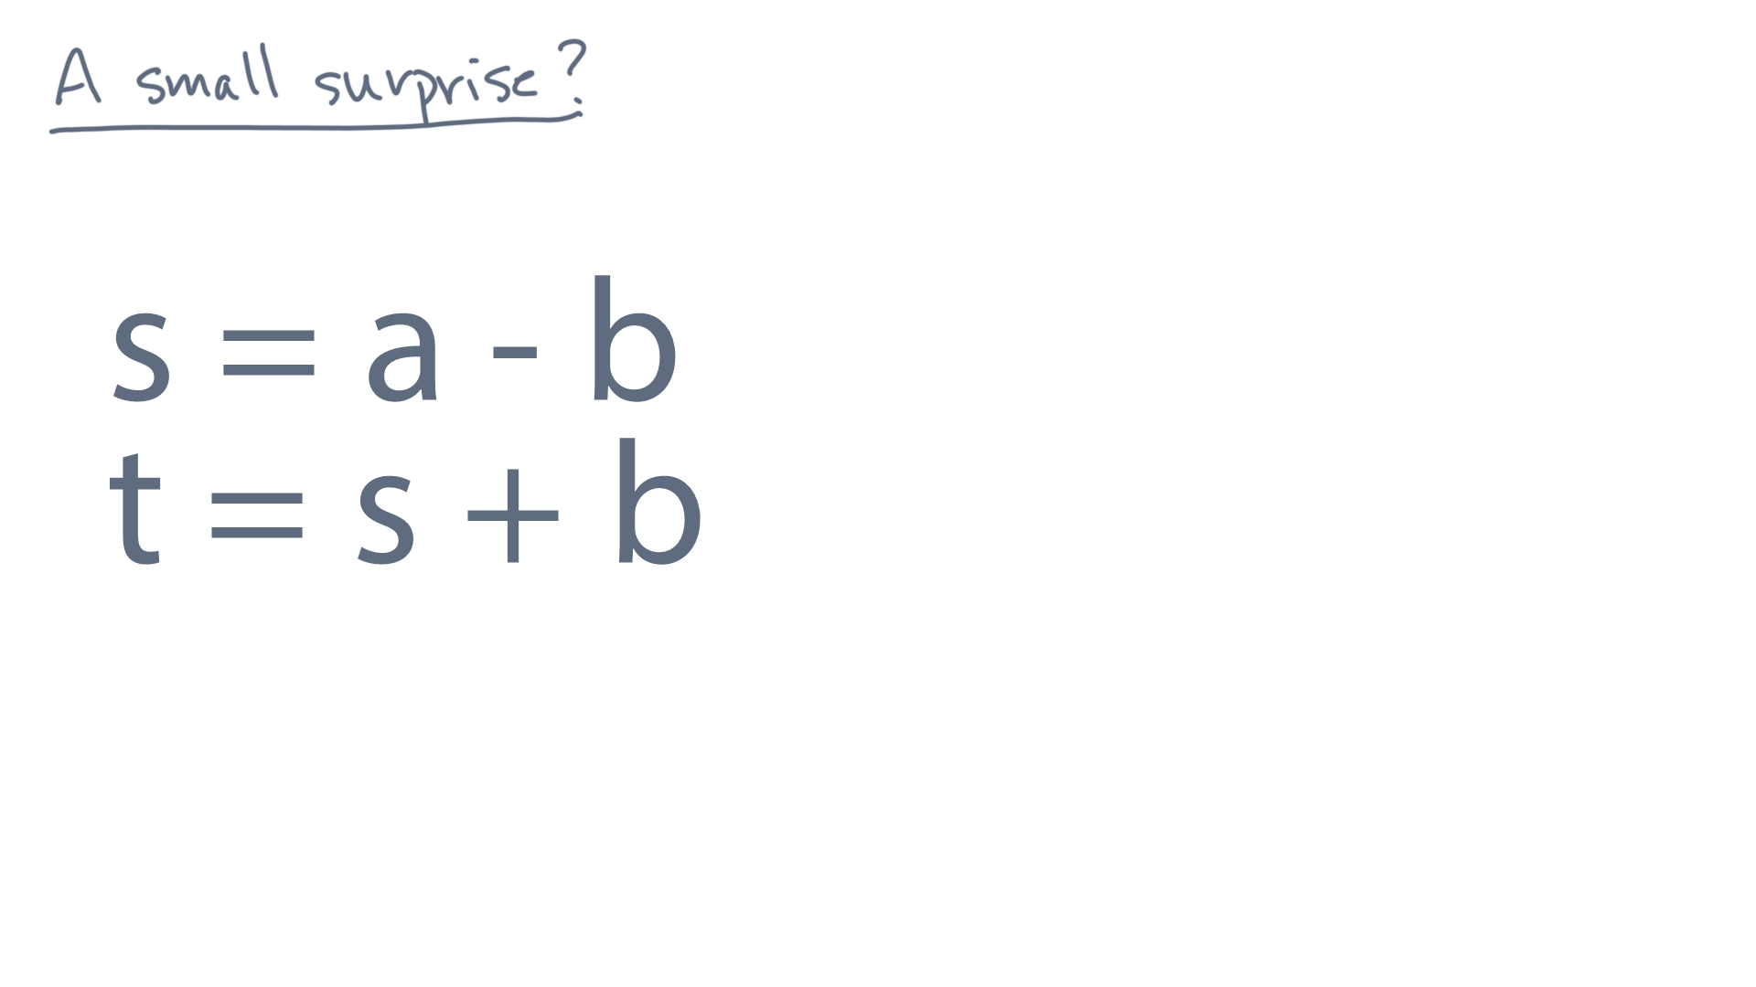
Notes:
Let’s call this Program 1.

Slide 4
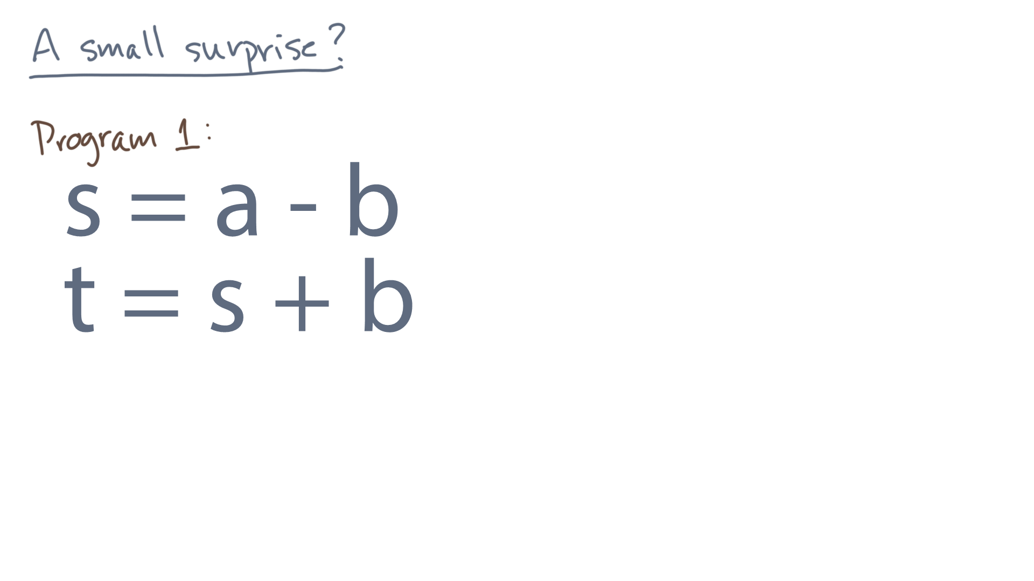
Notes:
I admit it’s kind of a silly program.
But take a moment to pause and ask yourself, what value will the variable “t” as in Tom have after the program completes?

Slide 5
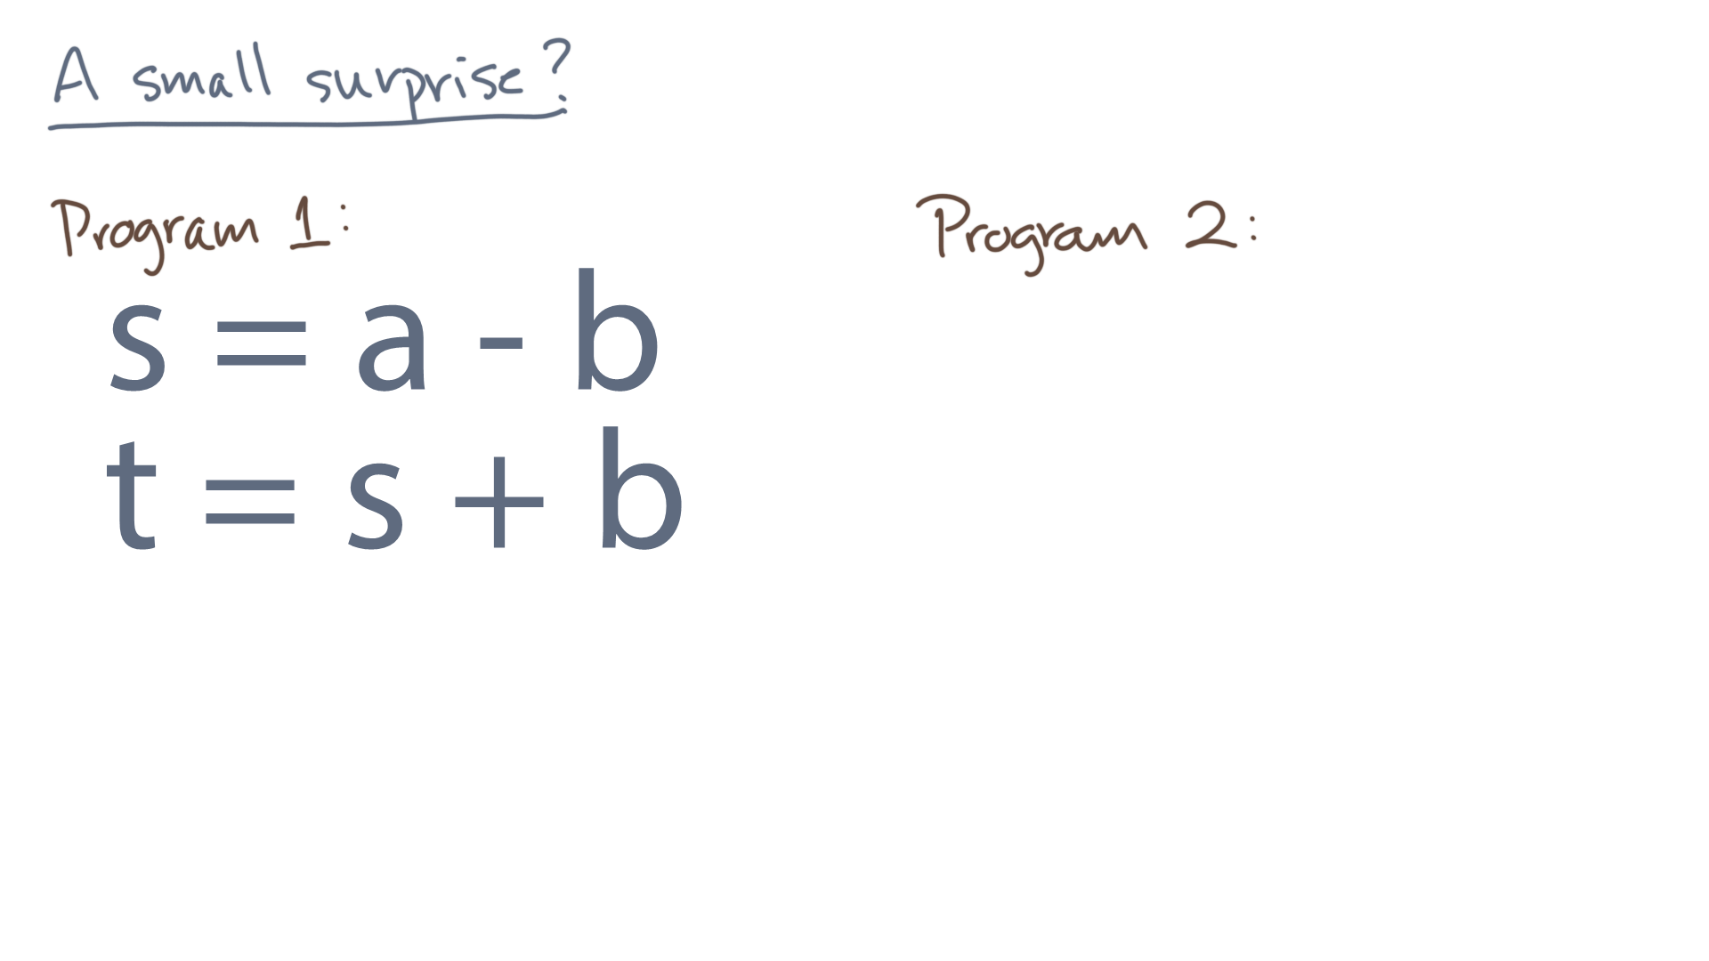
Notes:
Now let’s consider a different program, Program 2.

Slide 6
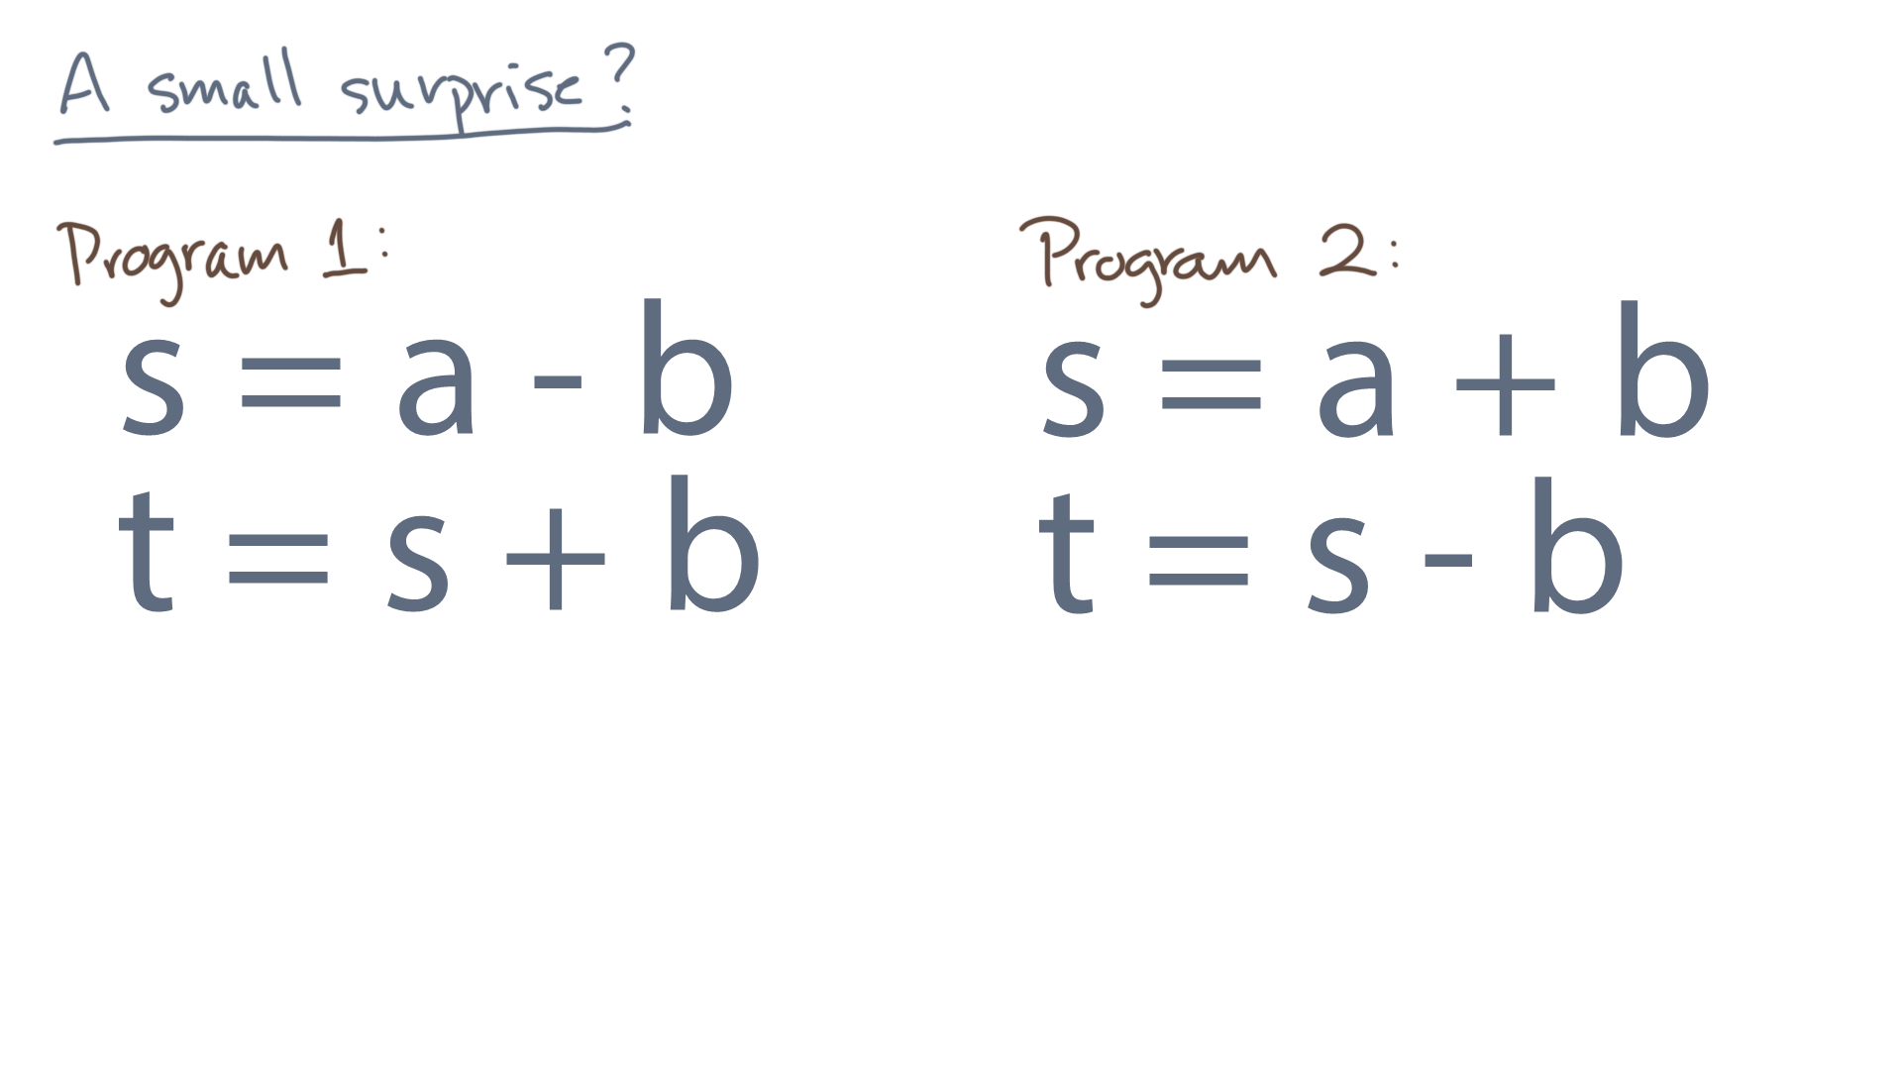
Notes:
Think about it, too, for a moment.
In fact, if you told me it should produce the same output, a reasonable person would agree!

Slide 7
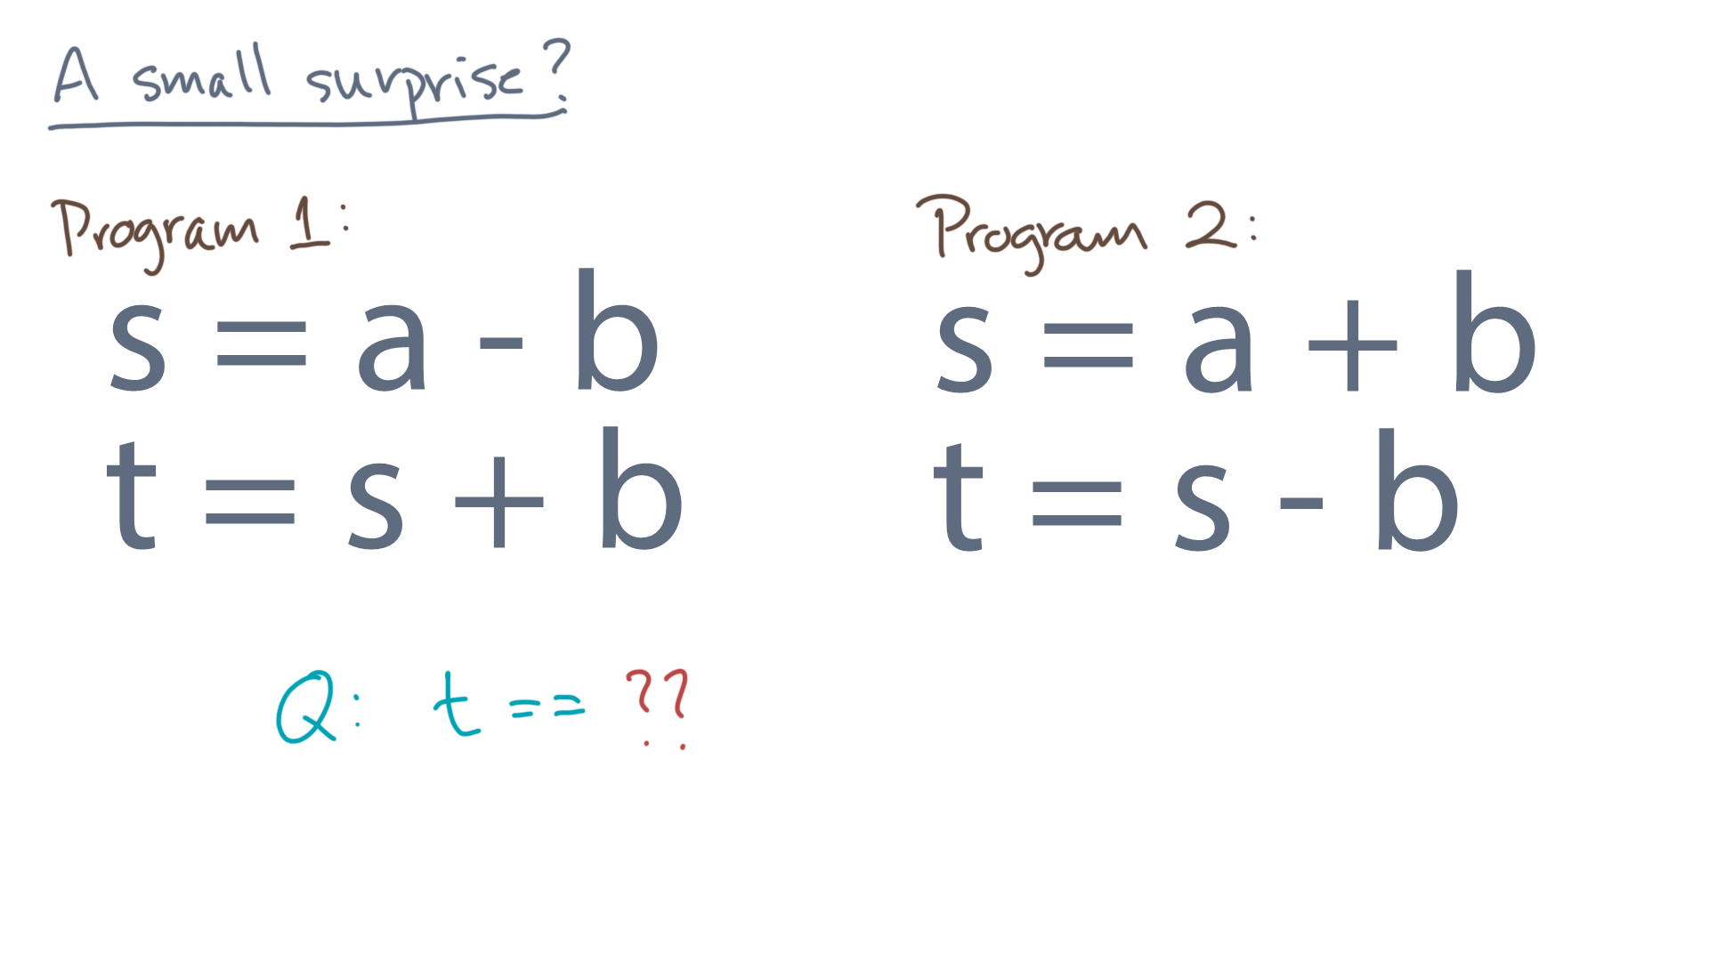
Notes:
And what would that person say?

Slide 8
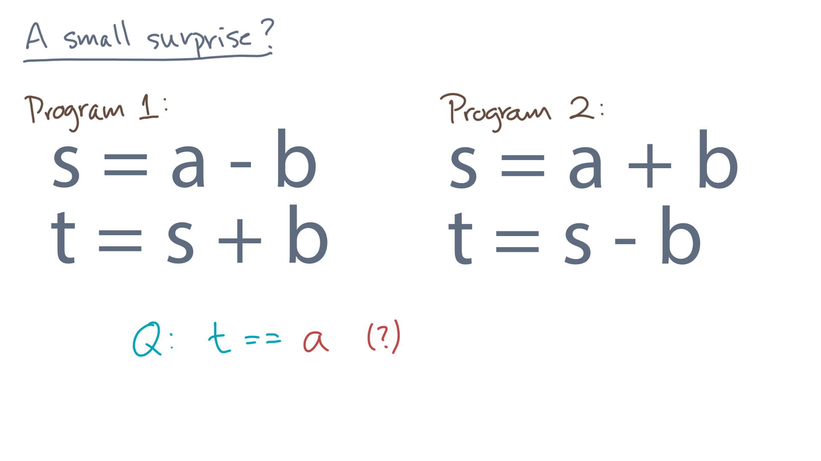
Notes:
If he or she said that “tee” should equal “a”, that seems right.
Or does it?
Let’s do an experiment.

Slide 9
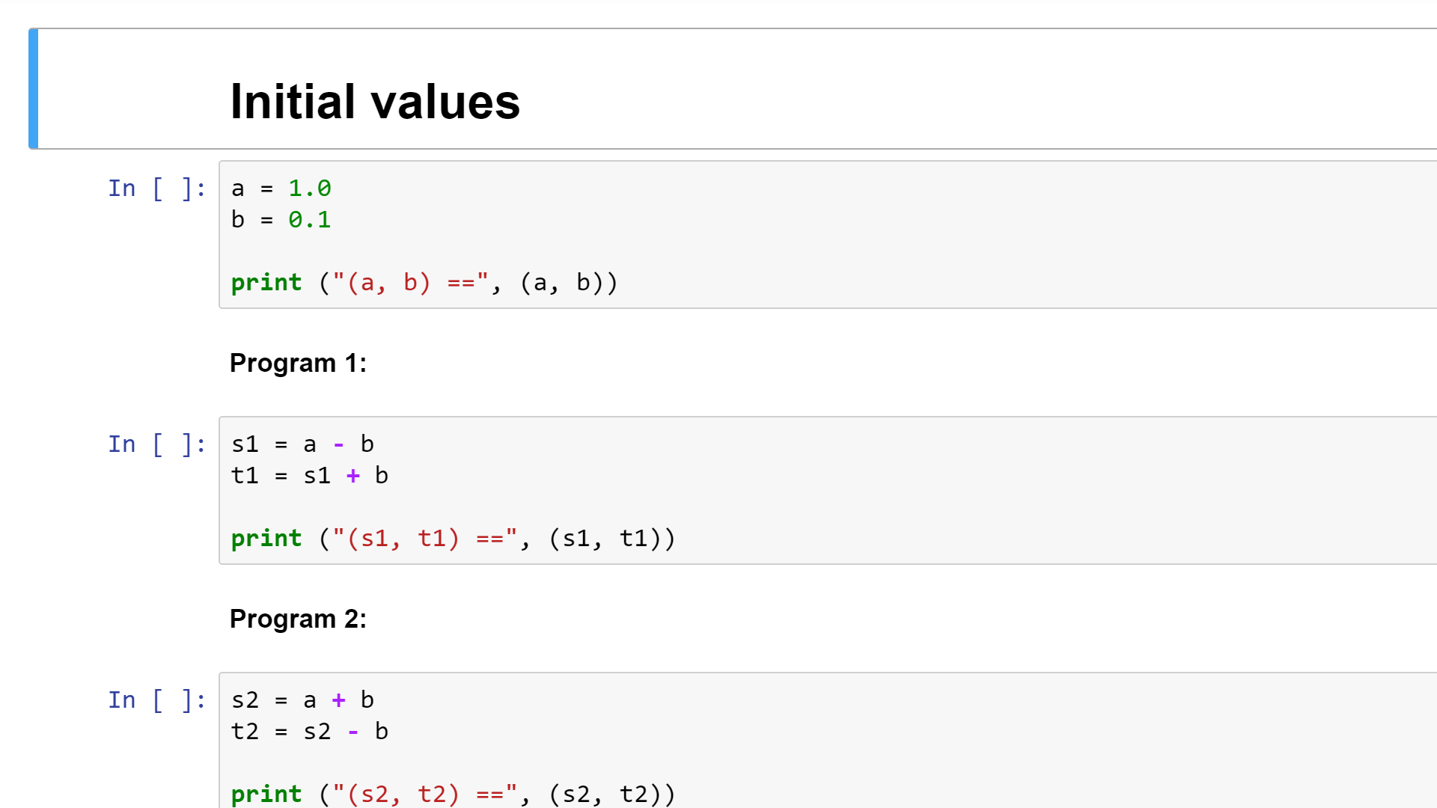
Notes:
Here is a Python notebook containing the two program fragments.

Slide 10
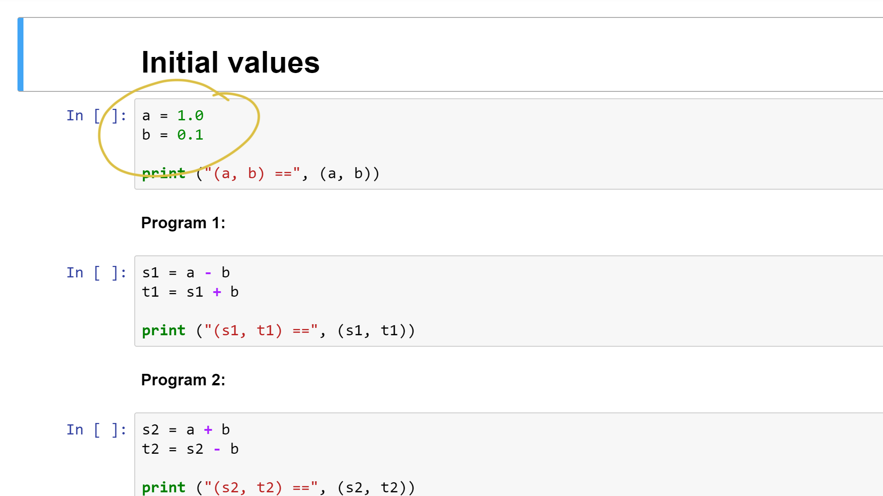
Notes:
Check out the initial values, 1 and 0.1.
Because you are very observant, you might already be suspicious!

Slide 11
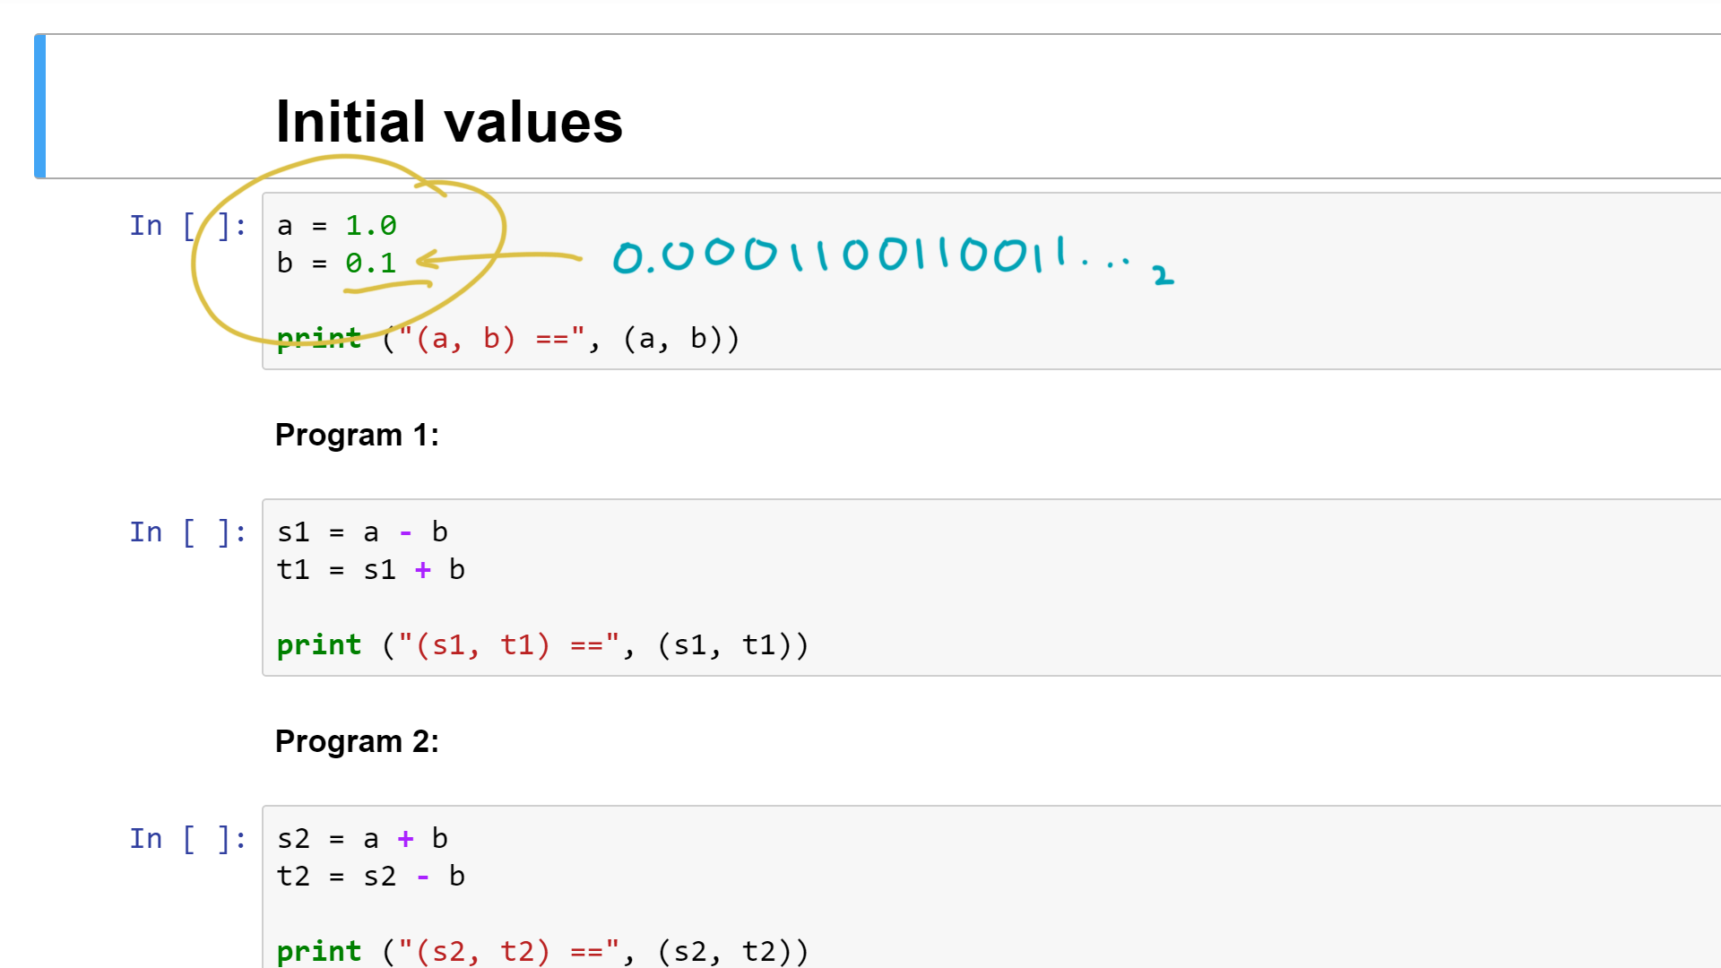
Notes:
In particular, you know that the machine usually stores numbers in binary.
Yet “0.1” in base 10 expands to an infinite binary representation.
Does that mean the programs will produce different results?
Let’s run it and see.

Slide 12
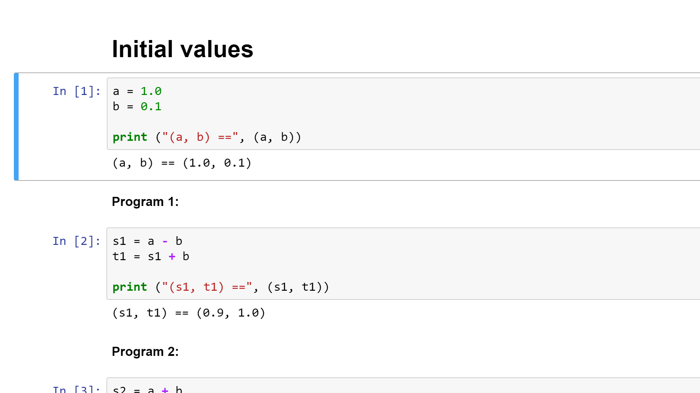
Notes:
Here is the output.
Everything looks normal at the beginning.

Slide 13
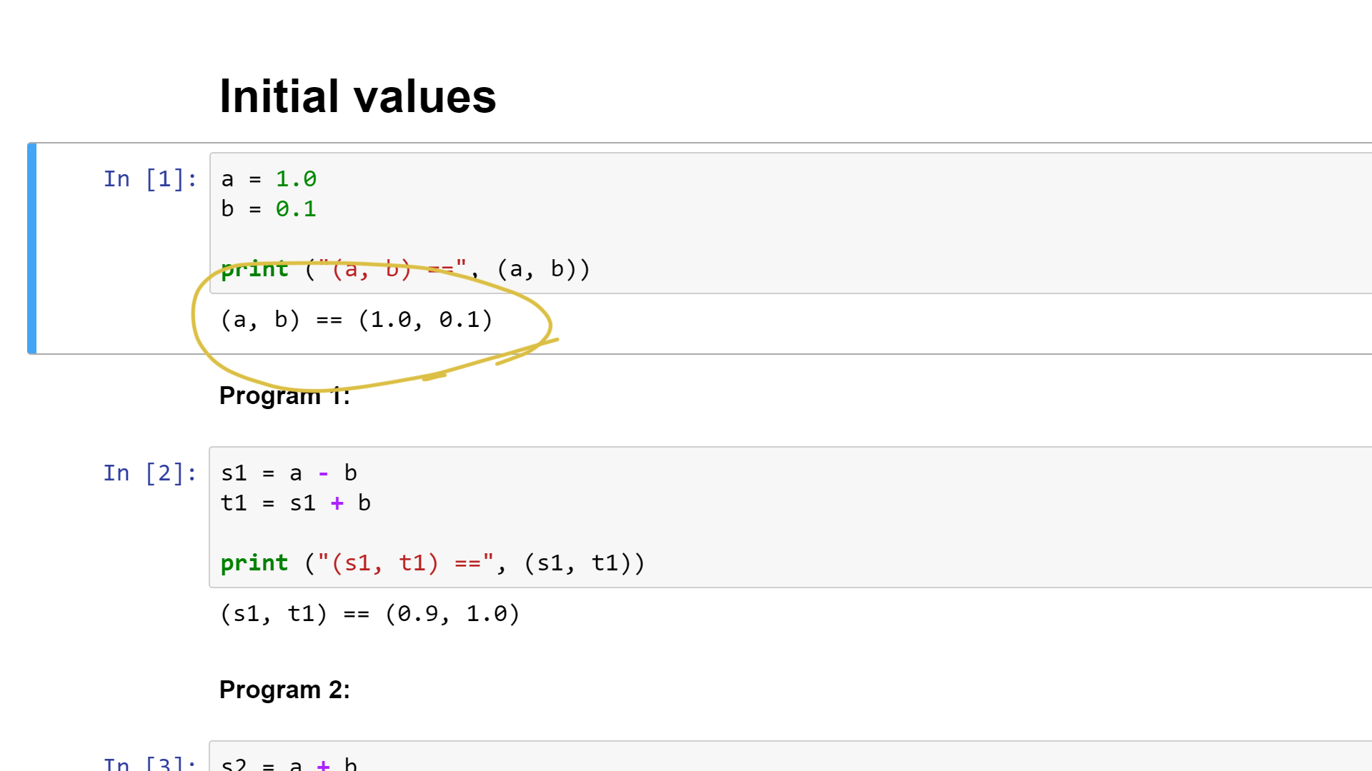
Notes:
And what about Programs 1 and 2?

Slide 14
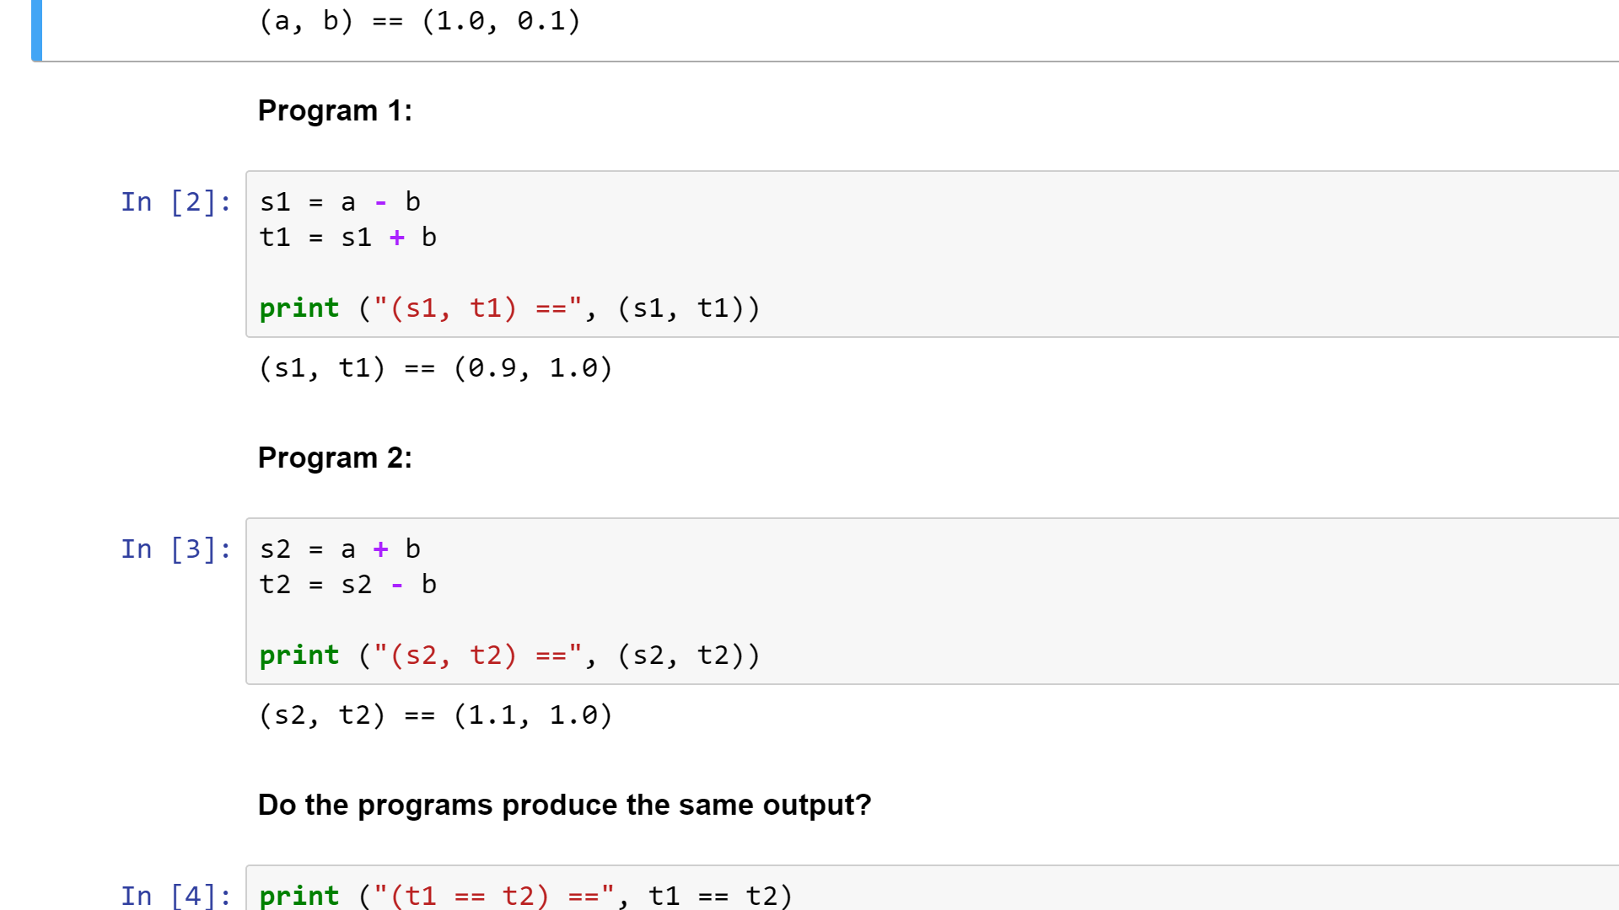
Notes:
Well, it appears that they produce the same output.

Slide 15
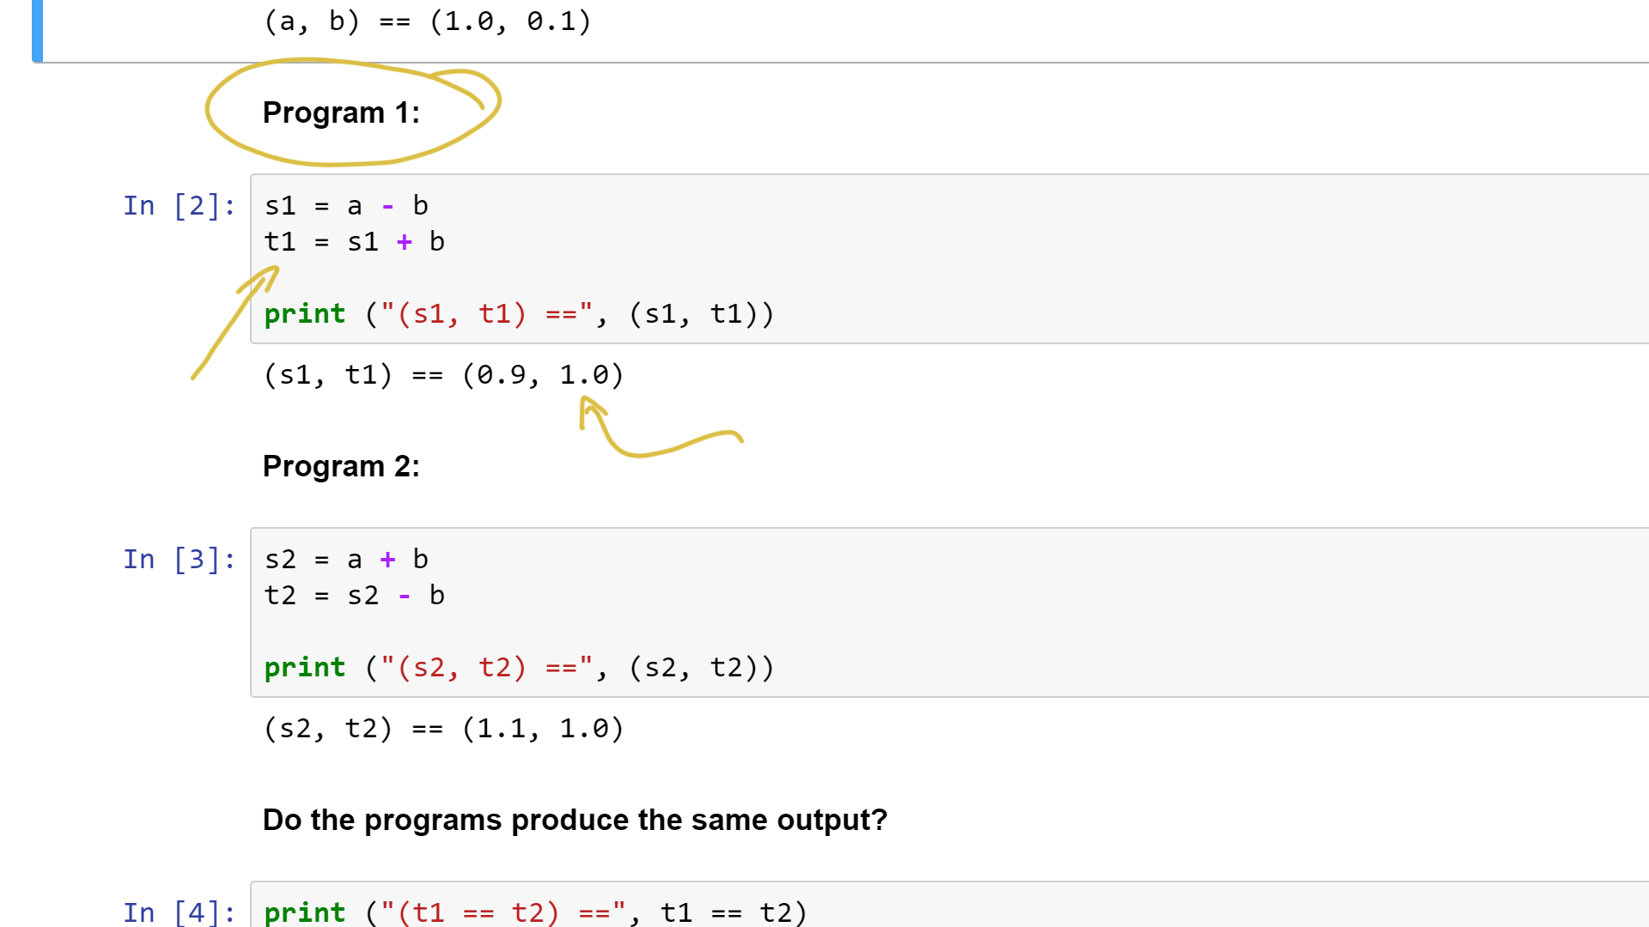
Notes:
Tee-1 from Program 1 equals 1.0.

Slide 16
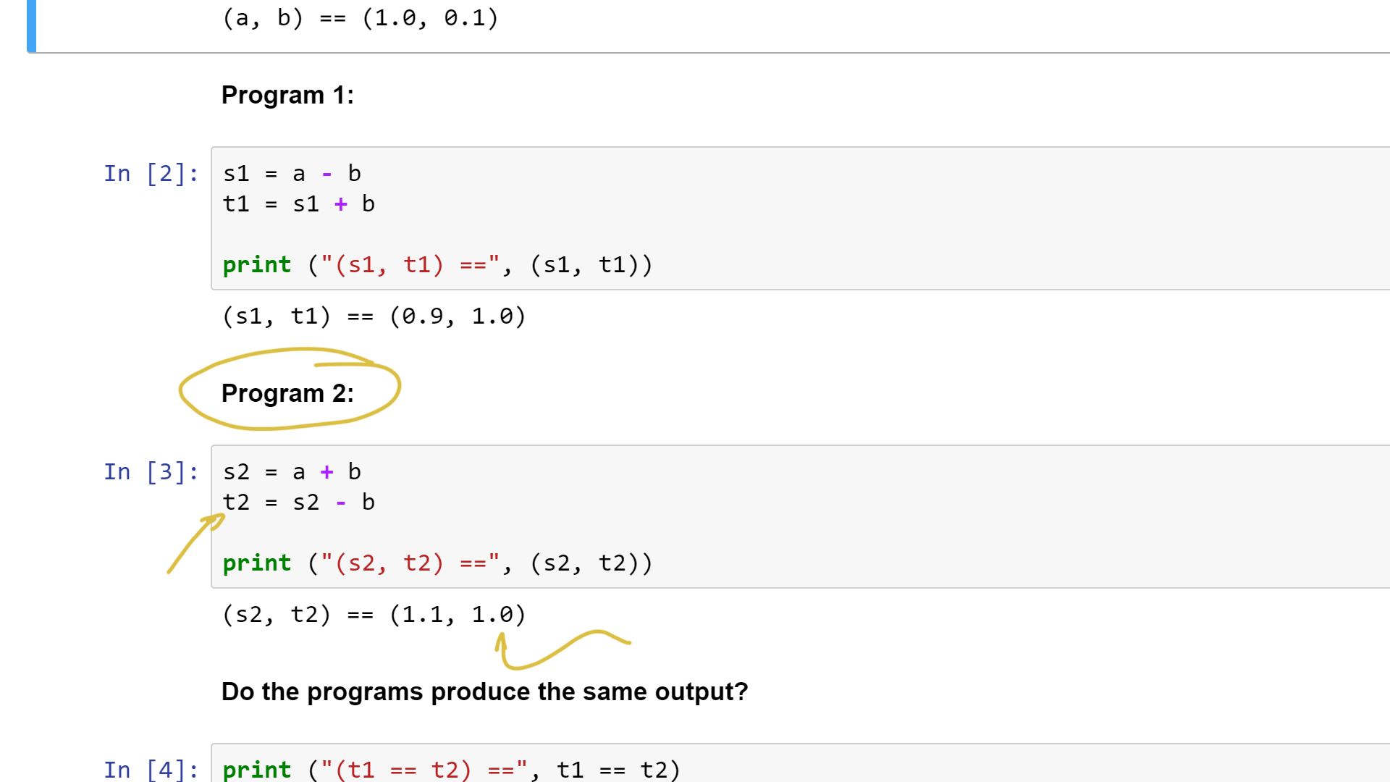
Notes:
The same is true for Program 2.

Slide 17
Notes:
I’ve added a little assertion at the end, just to make sure.

Slide 18
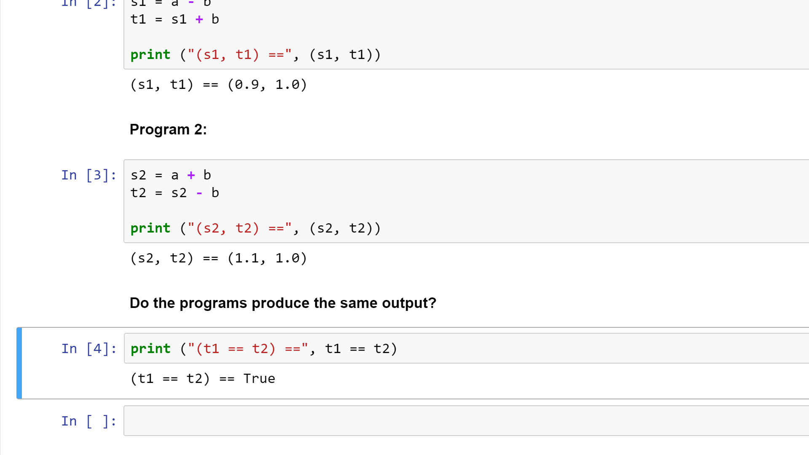

Slide 19
Notes:
The assertion passes, so everything seems OK!
So what’s the big deal? Let’s try a different input.

Slide 20
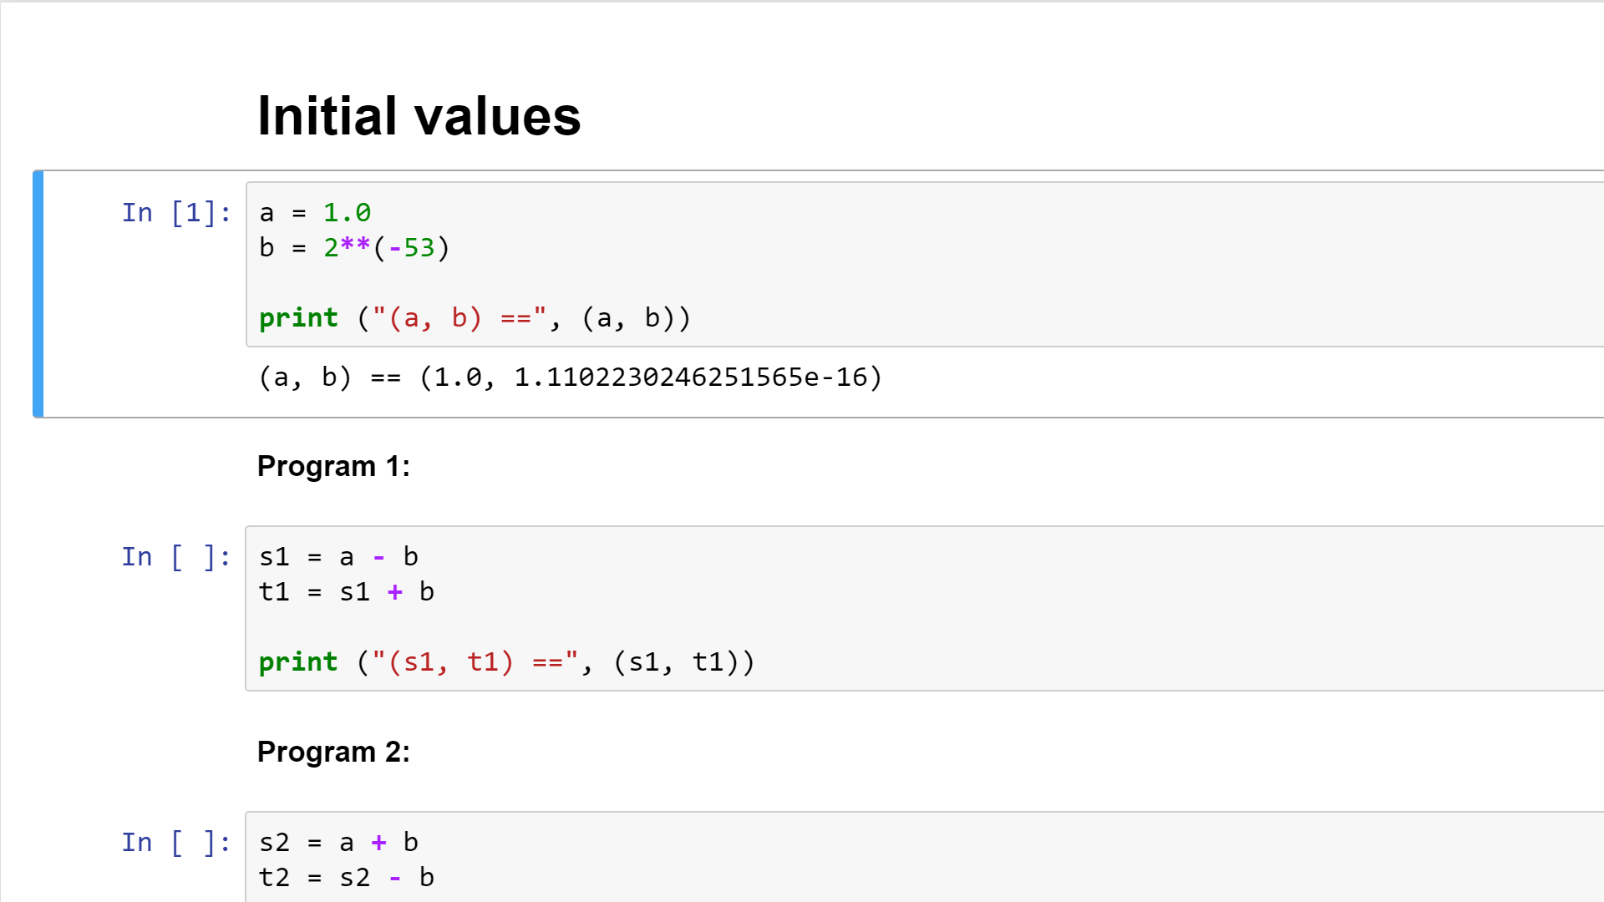
Notes:
In this case, I’ve picked the value of “bee” to be an exact power of two.

Slide 21
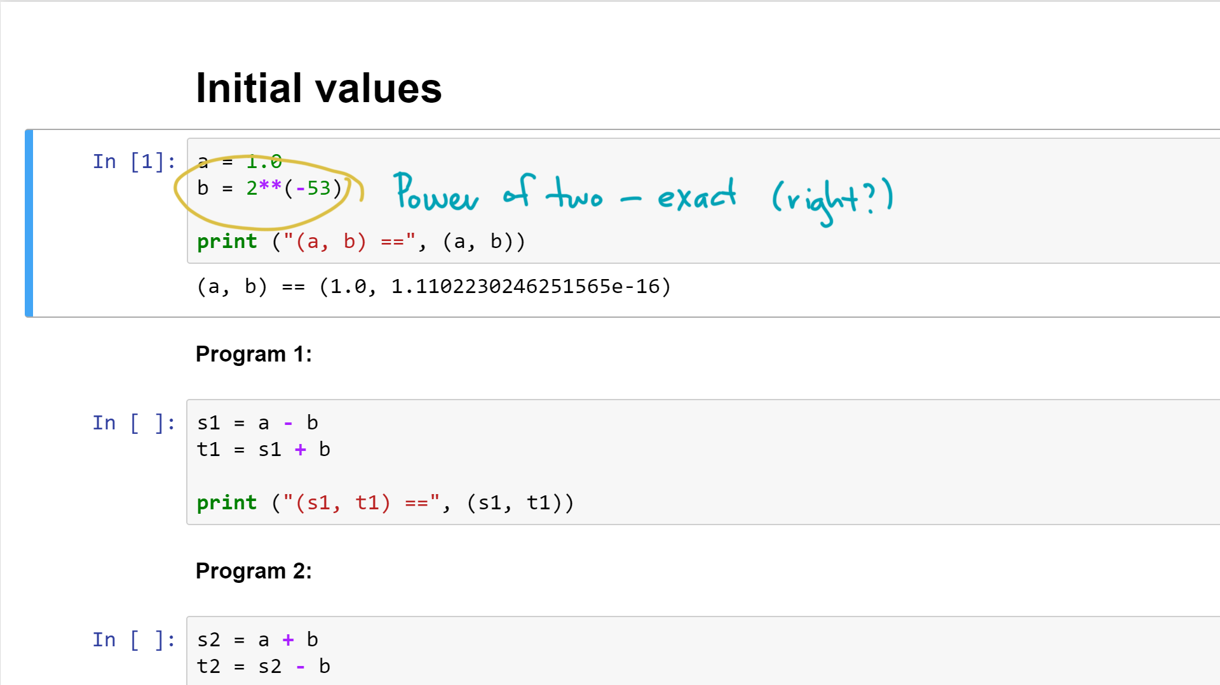
Notes:
Since the computer stores everything in binary, unlike the previous example, this value can be represented exactly.

Slide 22
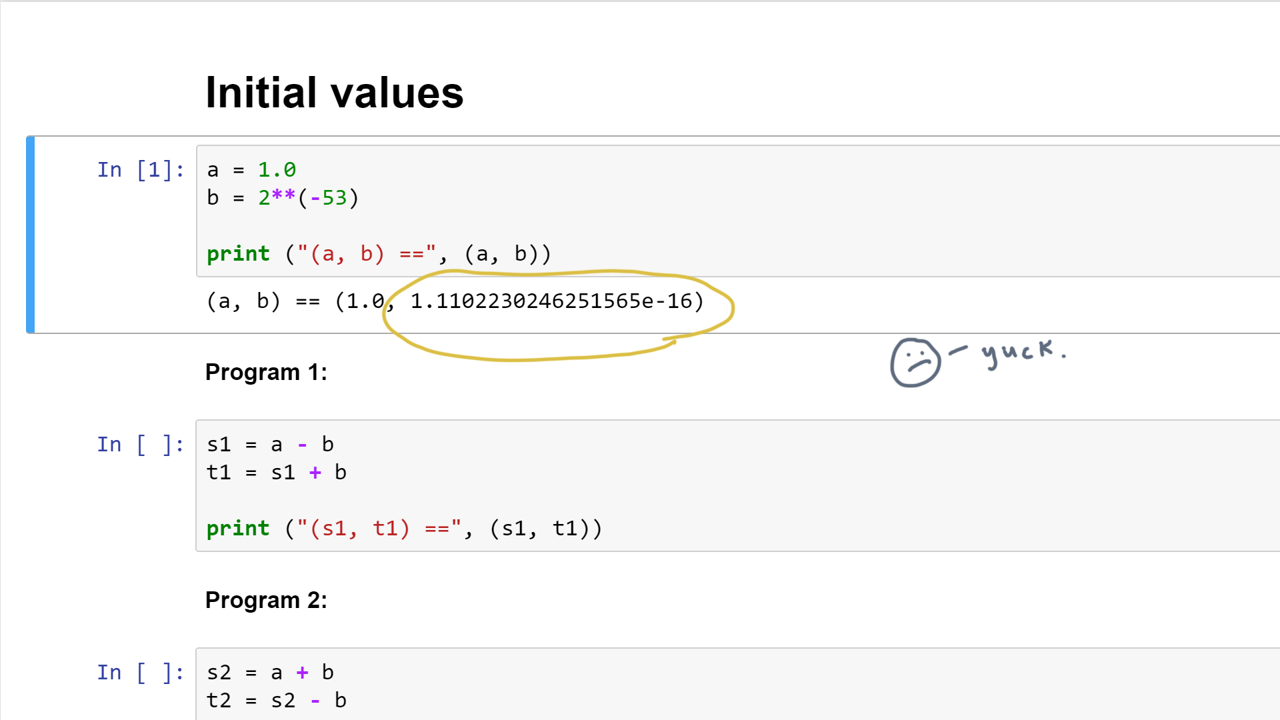
Notes:
And that’s true even though the printed output, which is in base-10, shows a messy output.

Slide 23
Notes:
So let’s run the two programs again.

Slide 24
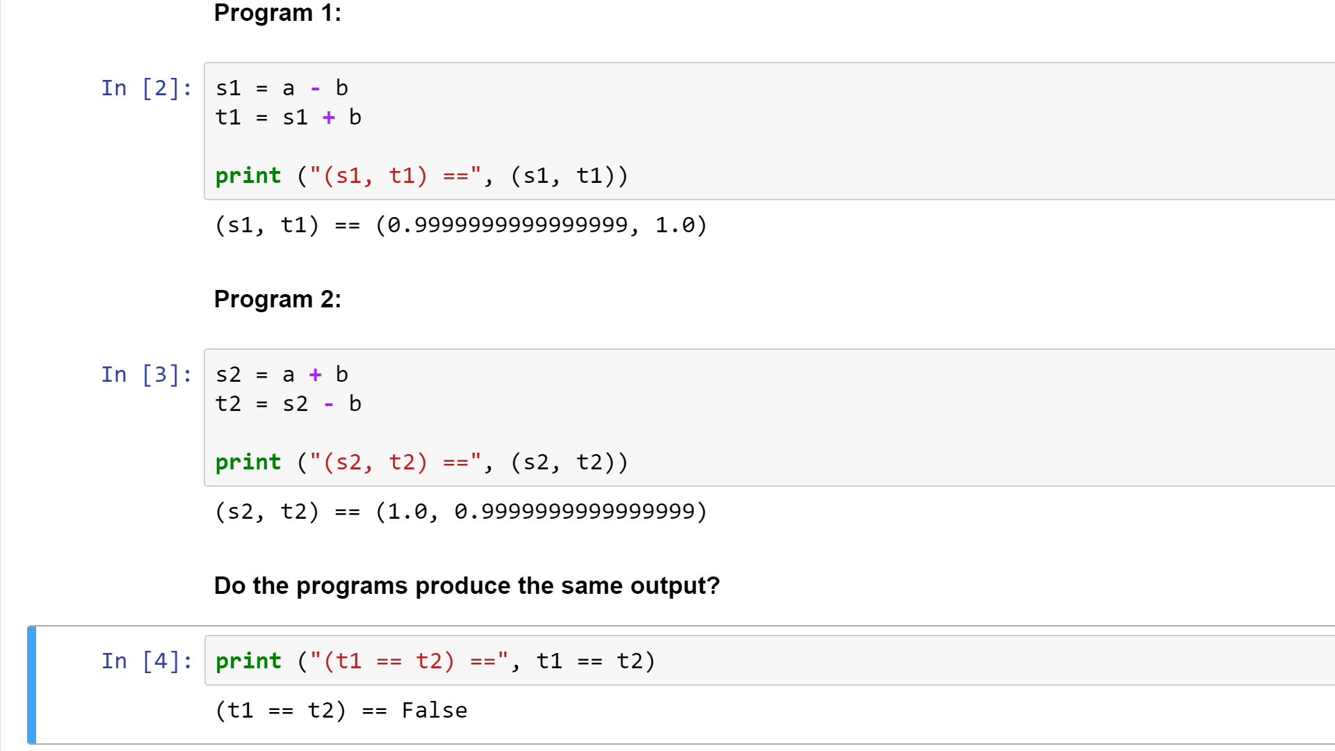
Notes:
It looks like they’ve produced slightly different results!

Slide 25
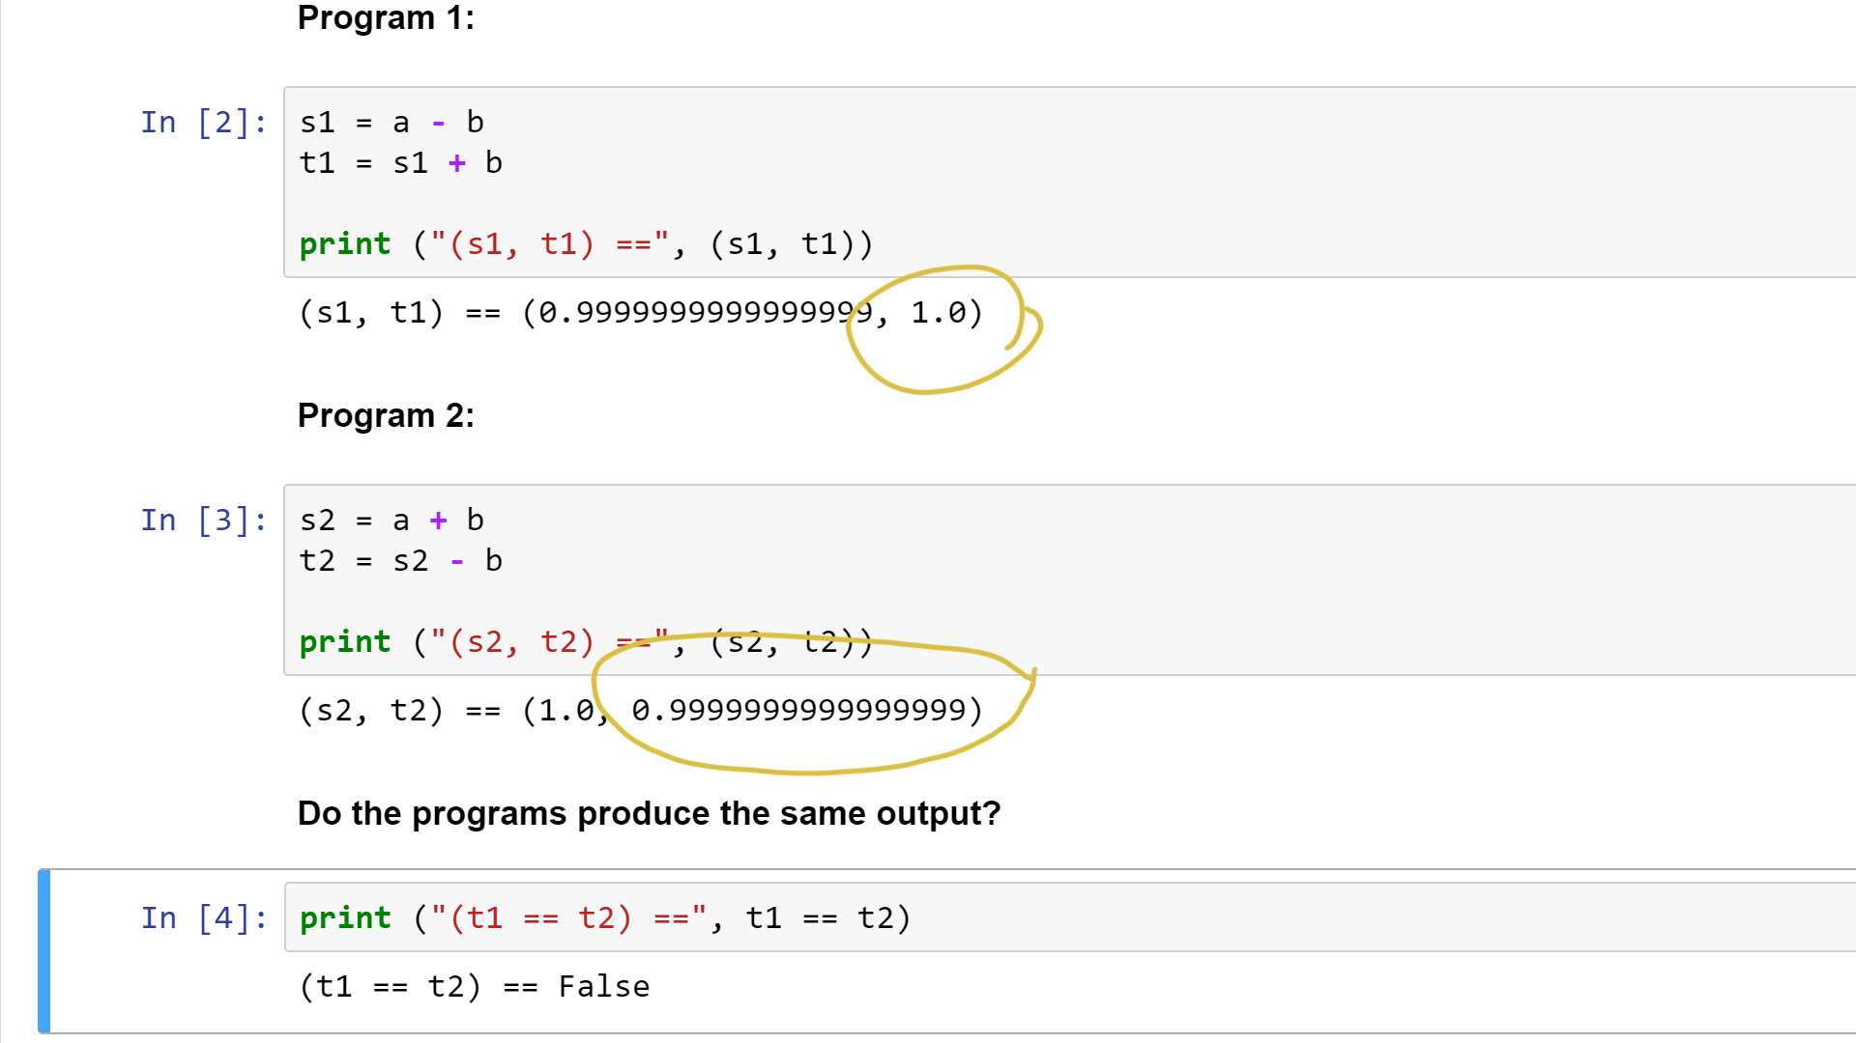
Notes:
Indeed, this fact causes the assertion to fail, too.

Slide 26
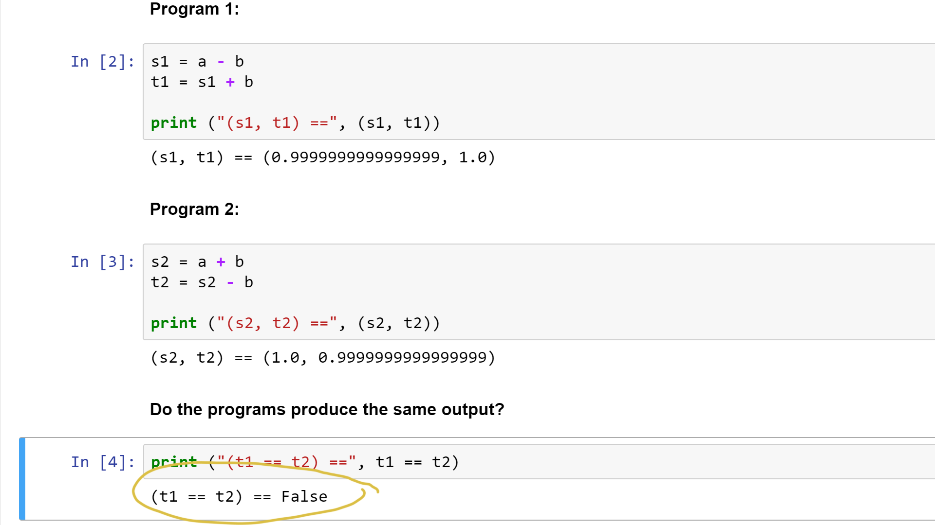
Notes:
So what’s going on?

Slide 27
Notes:
In one case, with inexact inputs, the two programs produced exactly the same results.
Yet with exactly represented inputs, the two programs can produce different results.
With everything you know so far, you should be able to explain what just happened.
So take a moment to think about that. And when you return, we’ll dive into the details.

